Slide 1
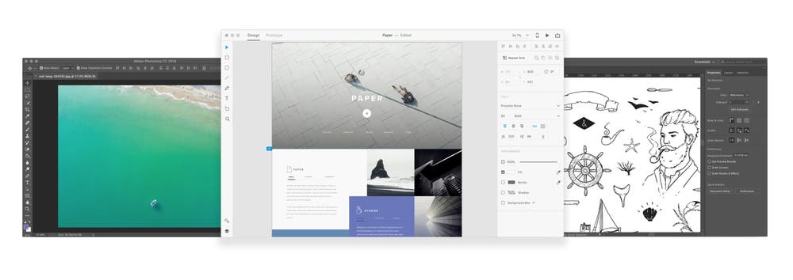



Graphics in Web Design
Graphics in Web Design
Photo – Adobe Stock
Notes:
Photo of 3 screen sizes responsive design
a good example of how content should scale across screens. Easy to read

Slide 2
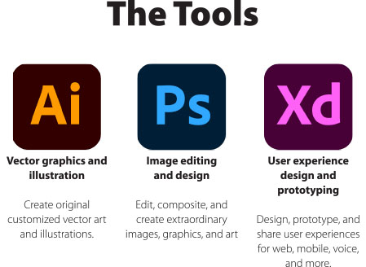
The Software
Download the Software: Illustrator, Photoshop, XD

Slide 3
The purpose and value of graphic design in web development (cont’d)
The purpose and value of graphic design in web development
A properly designed website is a part of a “brand” which is more than coding and grid patterns. Graphic design captures the emotional spirit, the visual story, and should be the heart and soul of the of the website.
Good graphic design can increase the value of the brands overall image visual appeal, usability, and professionalism.
Good design communicates ideas to views that are appealing to the users senses

Slide 4
The purpose and value of graphic design in web development (cont’d, 2)
The purpose and value of graphic design in web development
When creating a company branding or identity we usually start the creative process with a logo that is unique in design and will standout in the marketplace. For examples logos must be scalable for print and web purposes.
Graphic design combines images and text that is compelling to read and will attract the user to continue to view and read.
Good design stands out and communicates a message effectively.
Bad design that does not communicate the right visual content and information can destroy a company or app.

Slide 5
The role of the customer or client in the graphic design process
Gather the facts - Fact-finding
Collect information to create a design that meets the right goals.
Prepare, and talk to your web design client, ask questions, use a questionnaire or survey to gather info about your client's company.
Get to know the client and their business upfront. Use meetings, telephone conversation, conference calls, email, face-to-face. Take notes, or record the meeting and transcribe the key information from the meeting to gather info.

Slide 6
The role of the customer or client in the graphic design process (cont’d)
Ask the correct questions.
Company branded properties
Social media
Media coverage
Press releases
Fan reviews and comments
Competitors (Content, search rankings, etc.)
Remember Content is the Important Key

Slide 7
The role of the customer or client in the graphic design process (cont’d, 2)
Create a website content list to block or chunk out of the information
Content inventory
Essential information
Domain information
Social media information
Customer information
Target market, demographics
Analytics (Goggle Analytics)
Email marketing information reports
Get your clients input and additions to your list
Get the full picture of the client and their business.

Slide 8
The purpose and value of graphics
Communicating with the client and asking the right questions about your client’s business and brand goals are crucial to meeting their expectations - and ultimately for all involved to launch a finished design project successfully.
Notes:
We will have fun exploring the software while learning how to build vital web assets.

Slide 9
Share designs with clients early on
When creating a concept or a design the 'look and feel’, make sure that the client and you are both on the same page as soon as possible.
Avoid spending too much time (and time is money) on a concept before sharing it with the client.
Communicating with the client and asking the right questions about your client’s business and brand goals are crucial to meeting their expectations - and ultimately for all involved to launch a finished design project successfully.

Slide 10
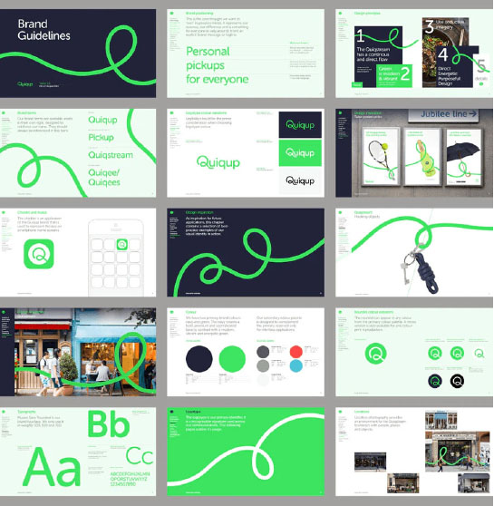
Brand Style Guide Example
Consistency and content is king to creating style guides, and web assets to help keep teams and collaborators on the same page when applying designs consistently through the development process.
Notes:
Consistency and content is king to creating style guides, and web assets to help keep teams and collaborators on the same page when applying designs consistently through the development process.

Slide 11

Web App Design System
Consistency and content is king to creating style guides, and web assets to help keep teams and collaborators on the same page when applying designs consistently through the development process.
Notes:
Consistency and content is king to creating style guides, and web assets to help keep teams and collaborators on the same page when applying designs consistently through the development process.

Slide 12

Graphic Design is Everywhere
Photo by Unsplash

Slide 13
Graphics in Web Design (cont’d)
Graphic Designers are often the protectors of design consistency and content.
Designer’s play a major role in setting up the standards for style guides, and web assets to help keep teams and collaborators on the same page when applying designs consistently throughout the development process.

